Slide 1
Extended Entity Relationship Model
© Shamkant B. Navathe
CC

Slide 2
Enhanced-ER (EER) Model Concepts
Includes all modeling concepts of basic ER
Additional concepts: subclasses/superclasses, specialization/generalization, categories, attribute inheritance
The resulting model is called the enhanced-ER or Extended ER (E2R or EER) model
It is used to model applications more completely and accurately if needed
It includes some object-oriented concepts, such as inheritance
© Shamkant B. Navathe
CC

Slide 3
Subclasses and Superclasses (1)
An entity type may have additional meaningful subgroupings of its entities
Example: EMPLOYEE may be further grouped into SECRETARY, ENGINEER, MANAGER, TECHNICIAN, SALARIED_EMPLOYEE, HOURLY_EMPLOYEE,…
  Each of these groupings is a subset of EMPLOYEE entities
  Each is called a subclass of EMPLOYEE
  EMPLOYEE is the superclass for each of these subclasses
These are called superclass/subclass relationships.
Example: EMPLOYEE/SECRETARY, EMPLOYEE/TECHNICIAN
© Shamkant B. Navathe
CC

Slide 4
Subclasses and Superclasses (2)
These are also called IS-A relationships (SECRETARY IS-A EMPLOYEE, TECHNICIAN IS-A EMPLOYEE, …).
Note: An entity that is member of a subclass represents the same real-world entity as some member of the superclass
  The Subclass member is the same entity in a distinct specific role
  An entity cannot exist in the database merely by being a member of a subclass; it must also be a member of the superclass
  A member of the superclass can be optionally included as a member of any number of its subclasses
Example: A salaried employee who is also an engineer belongs to the two subclasses ENGINEER and SALARIED_EMPLOYEE
  It is not necessary that every entity in a superclass be a member of some subclass
© Shamkant B. Navathe
CC

Slide 5
Attribute Inheritance in Superclass / Subclass Relationships
An entity that is member of a subclass inherits all attributes of the entity as a member of the superclass
It also inherits all relationships
© Shamkant B. Navathe
CC

Slide 6
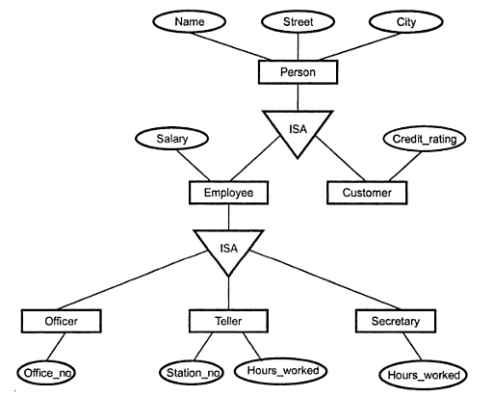
Example of a Specialization
© Shamkant B. Navathe
CC

Slide 7
Specialization
Is the process of defining a set of subclasses of a superclass
The set of subclasses is based upon some distinguishing characteristics of the entities in the superclass
Example: {SECRETARY, ENGINEER, TECHNICIAN} is a specialization of EMPLOYEE based upon job type.
  May have several specializations of the same superclass
Example: Another specialization of EMPLOYEE based in method of pay is {SALARIED_EMPLOYEE, HOURLY_EMPLOYEE}.
  Superclass/subclass relationships and specialization can be diagrammatically represented in EER diagrams
  Attributes of a subclass are called specific attributes. For example, TypingSpeed of SECRETARY
  The subclass can participate in specific relationship types. For example, BELONGS_TO of HOURLY_EMPLOYEE
© Shamkant B. Navathe
CC

Slide 8
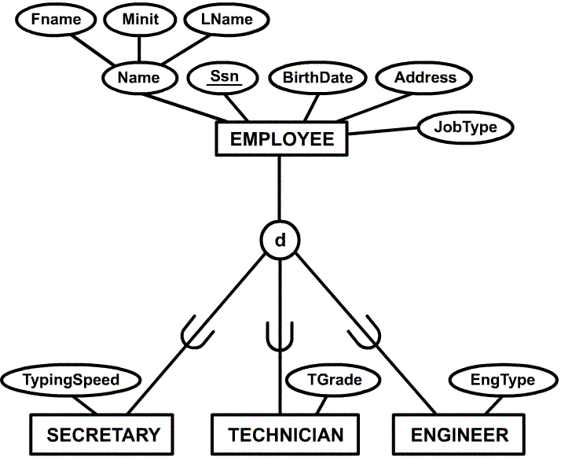
Example of a Specialization
© Shamkant B. Navathe
CC

Slide 9
Generalization
The reverse of the specialization process
Several classes with common features are generalized into a superclass; original classes become its subclasses
Example: CAR, TRUCK generalized into VEHICLE; both CAR, TRUCK become subclasses of the superclass VEHICLE.
  We can view {CAR, TRUCK} as a specialization of VEHICLE
  Alternatively, we can view VEHICLE as a generalization of CAR and TRUCK
© Shamkant B. Navathe
CC

Slide 10
Generalization and Specialization
Diagrammatic notation sometimes used to distinguish between generalization and specialization
  Arrow pointing to the generalized superclass represents a generalization
  Arrows pointing to the specialized subclasses represent a specialization
  We do not use this notation because it is often subjective as to which process is more appropriate for a particular situation
  We advocate not drawing any arrows in these situations
Data Modeling with Specialization and Generalization
  A superclass or subclass represents a set of entities
  Shown in rectangles in EER diagrams (as are entity types)
  Sometimes, all entity sets are simply called classes, whether they are entity types, superclasses, or subclasses
© Shamkant B. Navathe
CC

Slide 11
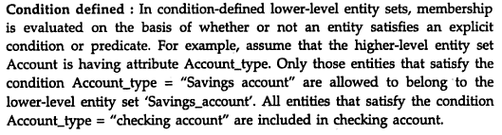
Constraints on Specialization and Generalization (1)
© Shamkant B. Navathe
CC

Slide 12
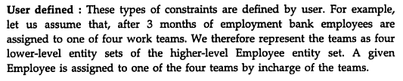
Constraints on Specialization and Generalization (1)
© Shamkant B. Navathe
CC

Slide 13
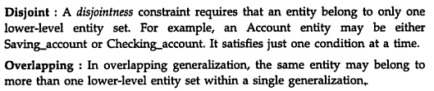
Constraints on Specialization and Generalization (1)
© Shamkant B. Navathe
CC

Slide 14
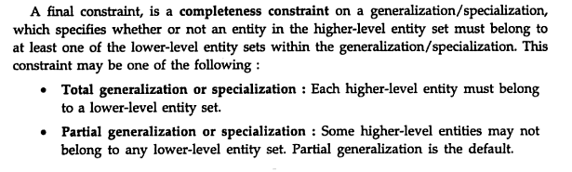
Constraints on Specialization and Generalization (1)
© Shamkant B. Navathe
CC

Slide 15
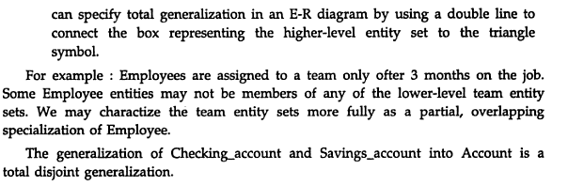
Constraints on Specialization and Generalization (1)
© Shamkant B. Navathe
CC

Slide 16
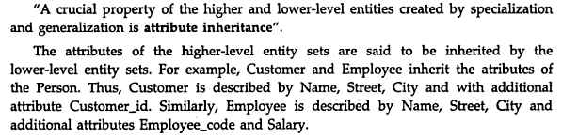
Attribute Inheritance
© Shamkant B. Navathe
CC

Slide 17
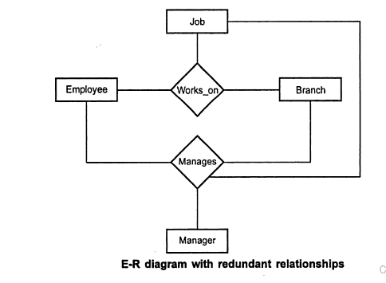
Aggregation
© Shamkant B. Navathe
CC

Slide 18
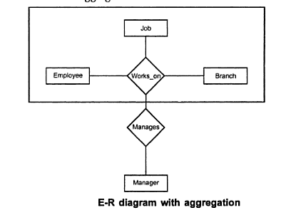
Aggregation
© Shamkant B. Navathe
CC

Slide 19
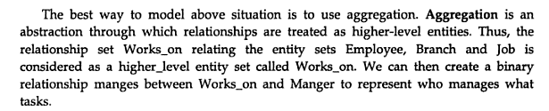
Aggregation
© Shamkant B. Navathe
CC

Slide 20

FIGURE 7.1
The ER conceptual schema diagram for the COMPANY database.

Slide 21

FIGURE 7.2
Result of mapping the COMPANY ER schema into a relational schema.

Slide 22
Constraints on Specialization and Generalization (1)
If we can determine exactly those entities that will become members of each subclass by a condition, the subclasses are called predicate-defined (or condition-defined) subclasses
  Condition is a constraint that determines subclass members
  Display a predicate-defined subclass by writing the predicate condition next to the line attaching the subclass to its superclass
If all subclasses in a specialization have membership condition on same attribute of the superclass, specialization is called an attribute defined-specialization
  Attribute is called the defining attribute of the specialization
  Example: JobType is the defining attribute of the specialization {SECRETARY, TECHNICIAN, ENGINEER} of EMPLOYEE
If no condition determines membership, the subclass is called user-defined
  Membership in a subclass is determined by the database users by applying an operation to add an entity to the subclass
  Membership in the subclass is specified individually for each entity in the superclass by the user
© Shamkant B. Navathe
CC

Slide 23
Constraints on Specialization and Generalization (2)
Two other conditions apply to a specialization/generalization:
Disjointness Constraint:
  Specifies that the subclasses of the specialization must be disjointed (an entity can be a member of at most one of the subclasses of the specialization)
  Specified by d in EER diagram
  If not disjointed, overlap; that is the same entity may be a member of more than one subclass of the specialization
  Specified by o in EER diagram
Completeness Constraint:
  Total specifies that every entity in the superclass must be a member of some subclass in the specialization/ generalization
  Shown in EER diagrams by a double line
  Partial allows an entity not to belong to any of the subclasses
  Shown in EER diagrams by a single line
© Shamkant B. Navathe
CC

Slide 24
Constraints on Specialization and Generalization (3)
Hence, we have four types of specialization/generalization:
  Disjoint, total
  Disjoint, partial
  Overlapping, total
  Overlapping, partial
Note: Generalization usually is total because the superclass is derived from the subclasses.
© Shamkant B. Navathe
CC

Slide 25
Example of disjoint partial Specialization
© Shamkant B. Navathe
CC

Slide 26

Motivation for Aggregation

Slide 27
Aggregation (Cont.)
Aggregation is an important concept in database design where composite objects can be modelled during the design of database applications.
Without introducing redundancy, the following diagram represents:
  A student is guided by a particular instructor on a particular project
  A student, instructor, project combination may have an associated evaluation

Slide 28
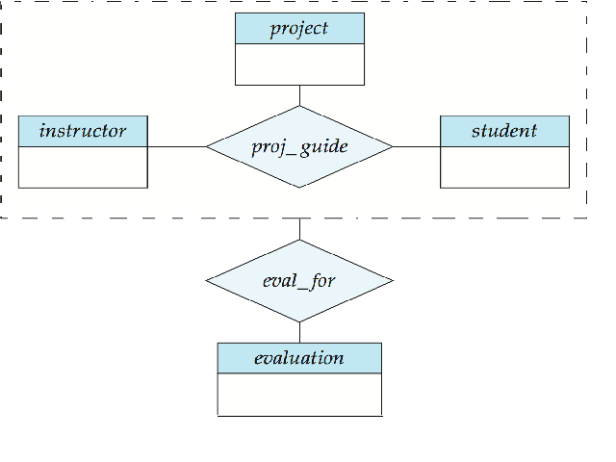
Aggregation - a feature of the entity relationship model that allows a relationship set to participate in another relationship set. This is indicated on an ER diagram by drawing a dashed box around the aggregation.
Aggregation - a feature of the entity relationship model that allows a relationship set to participate in another relationship set. This is indicated on an ER diagram by drawing a dashed box around the aggregation
Aggregation - a feature of the entity relationship model that allows a relationship set to participate in another relationship set. This is indicated on an ER diagram by drawing a dashed box around the aggregation.

Slide 29
Specialization / Generalization Hierarchies, Lattices and Shared Subclasses
A subclass may itself have further subclasses specified on it
Forms a hierarchy or a lattice
Hierarchy has a constraint that every subclass has only one superclass (called single inheritance)
In a lattice, a subclass can be subclass of more than one superclass (called multiple inheritance)
In a lattice or hierarchy, a subclass inherits attributes not only of its direct superclass, but also of all its predecessor superclasses
A subclass with more than one superclass is called a shared subclass
Can have specialization hierarchies or lattices, or generalization hierarchies or lattices
In specialization, start with an entity type and then define subclasses of the entity type by successive specialization (top down conceptual refinement process)
In generalization, start with many entity types and generalize those that have common properties (bottom up conceptual synthesis process)
In practice, the combination of two processes is employed
© Shamkant B. Navathe
CC

Slide 30
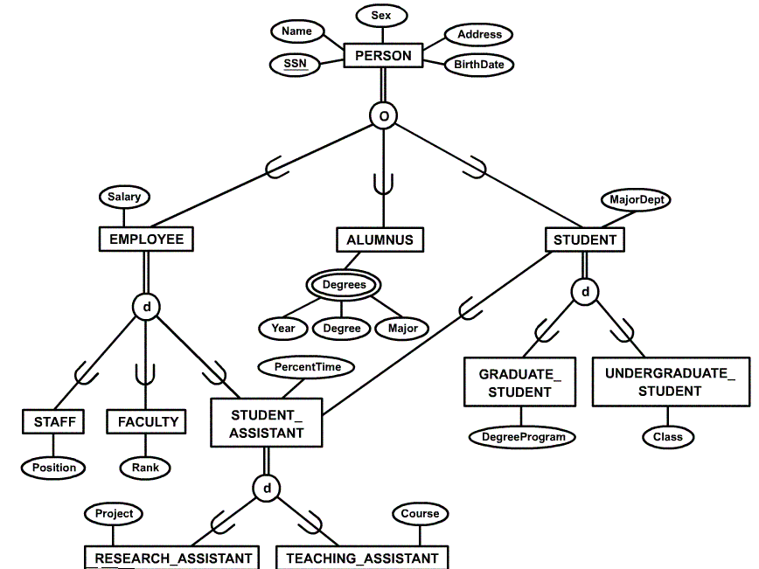
Specialization / Generalization Lattice Example (UNIVERSITY)
© Shamkant B. Navathe
CC

Slide 31
Categories (UNION TYPES)
All of the superclass/subclass relationships we have seen thus far have a single superclass
A shared subclass is subclass in more than one distinct superclass/subclass relationships, where each relationships has a single superclass (multiple inheritance)
In some cases, need to model a single superclass/subclass relationship with more than one superclass
Superclasses represent different entity types
Such a subclass is called a category or UNION TYPE
Example: Database for vehicle registration, vehicle owner can be a person, a bank (holding a lien on a vehicle) or a company.
  Category (subclass) OWNER is a subset of the union of the three superclasses COMPANY, BANK, and PERSON
  A category member must exist in at least one of its superclasses
Note: The difference from shared subclass, which is subset of the intersection of its superclasses (shared subclass member must exist in all of its superclasses).
© Shamkant B. Navathe
CC

Slide 32
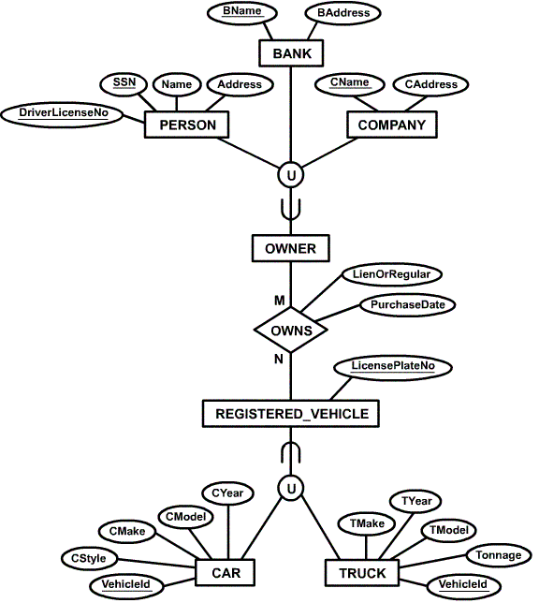
Example of categories
(UNION TYPES)
© Shamkant B. Navathe
CC

Slide 33
Formal Definitions of EER Model (1)
Class C: A set of entities; could be entity type, subclass, superclass, category.
Subclass S: A class whose entities must always be subset of the entities in another class, called the superclass C of the superclass/subclass (or IS-A) relationship S/C:
S ⊆ C
Specialization Z: Z = {S1, S2,…, Sn} a set of subclasses with same superclass G; hence, G/Si a superclass relationship for i = 1, …., n.
  G is called a generalization of the subclasses {S1, S2,…, Sn}
  Z is total if we always have:
  S1 ∪ S2 ∪ … ∪ Sn = G;
  Otherwise, Z is partial.
  Z is disjoint if we always have:
  Si ∩ S2 empty-set for i ≠ j;
  Otherwise, Z is overlapping.
© Shamkant B. Navathe
CC

Slide 34
Formal Definitions of EER Model (2)
Subclass S of C is predicate defined if predicate p on attributes of C is used to specify membership in S; that is, S = C[p], where C[p] is the set of entities in C that satisfy p
A subclass not defined by a predicate is called user-defined
Attribute-defined specialization: if a predicate A = ci (where A is an attribute of G and ci is a constant value from the domain of A) is used to specify membership in each subclass Si in Z
Note: If ci ≠ cj for i ≠ j, and A is single-valued, then the attribute-defined specialization will be disjoint.
Category or UNION type T
  A class that is a subset of the union of n defining superclasses
  D1, D2,…Dn, n>1:
  T ⊆ (D1 ∪ D2 ∪ … ∪ Dn)
  A predicate pi on the attributes of T.
  If a predicate pi on the attributes of Di can specify entities of Di that are members of T.
  If a predicate is specified on every Di: T = (D1[p1] ∪ D2[p2] ∪…∪ Dn[pn]
  Note: The definition of relationship type should have 'entity type' replaced with 'class'.
© Shamkant B. Navathe
CC

Slide 35
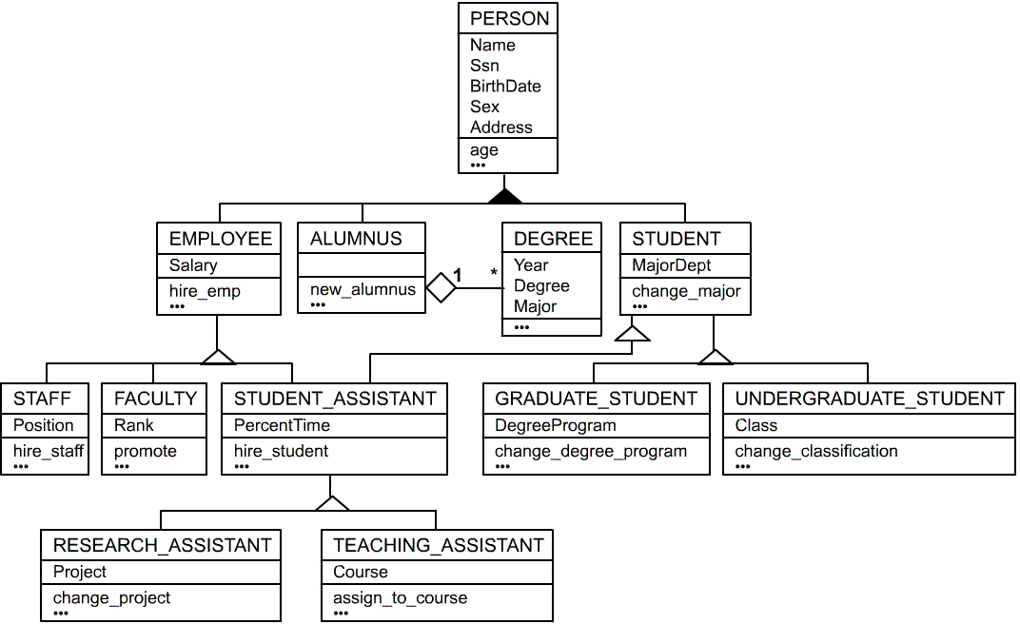
UML Example for Displaying Specialization / Generalization
© Shamkant B. Navathe
CC

Slide 36
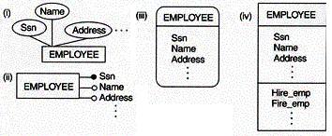

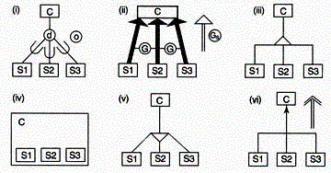
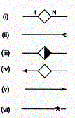
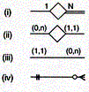
Alternative Diagrammatic Notations
Symbols for entity type / class, attribute and relationship
Displaying attributes
Notations for displaying specialization / generalization
Various (min, max) notations
Displaying cardinality ratios
© Shamkant B. Navathe
CC

